Slide 1

REFORM PROGRESS
IN UKRAINE

Slide 2


PRECONDITIONS FOR REFORMS:
EXTERNAL FACTORS
Russian occupation of Crimea and areas
of Donetsk and Luhansk regions
Industrial production dropped by 20%
About $ 200 mln monthly spent providing
utilities to the occupied territories
GDP dropped by 17-20% due to war and
annexation of Crimea
  Information war
  Large-scale information war launched by the
  Russian Federation inside and outside of Ukraine
  Hybrid war
  Ukraine became target for testing
  new forms and technologies for aggression
Military aggression by the Russian Federation
Military budget reached 5% of GDP in 2016 or UAH 113.6bn.
Six times more than in 2013.
  Trade and economic aggression
  of the Russia Federation
Revenues from export to Russia
reduced by $1-1.2 bn annually
Price drop for key Ukrainian exports
Export revenue in 2015 fell by
$25 bn (-39%) vs. 2013
  Energy aggression by the Russian Federation
Damage from loss of energy facilities in Crimea is
estimated at hundreds of billions dollars

Slide 3

PRECONDITIONS FOR REFORMS:
INTERNAL FACTORS
Inefficient law
enforcement and
judicial systems
  Ukrainian army was
  not prepared for
  modern hybrid warfare
  Corruption in the state system
  Broad corrupt practices across state institutions
  Volume of investigated corruption cases during
  2015 grew 35 times (est.value UAH 3 bn);
  UAH 1 bn is investigated by the
  National Anti-Corruption Bureau
  Foreign investments decreased due to external aggression
  Foreign direct investments in Ukraine decreased by $13.7 bn during 2014-2015
Exhausted financial and
banking systems
Banking system lost UAH120 bn
during 2014-2015
  Political and government changes
Parliamentary elections, local elections and several government changes took place over the two last years
  Terrorist attacks and
  sabotage activities
  on the territory of Ukraine
Ineffective system
of the state governance

Slide 4

UKRAINE
UNDERTAKES REFORMS
UNDER CHALLENGING
CONDITIONS

Slide 5


FINANCIAL SUPPORT
PER CAPITA
Ukraine is approaching Slovakia level of financing
However, Slovakia has not experienced such stress–factors as Ukraine.

Slide 6
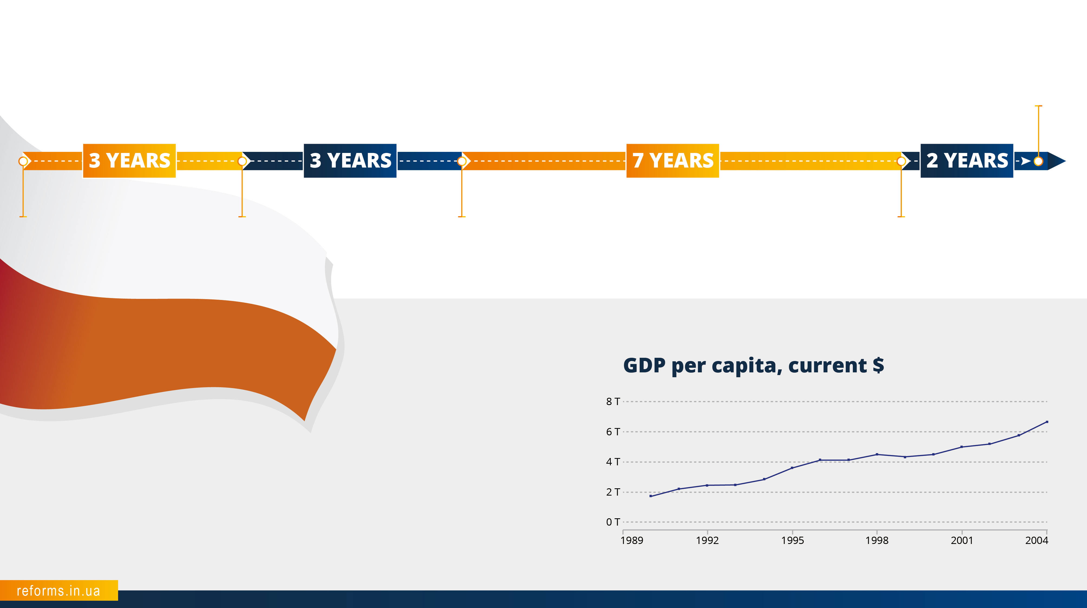
COUNTRY CASE:
POLAND
2004
Admission to EU
1989
Beginning of reforms
1992
First signs of recovery
1995
Back to
GDP growth
2002
Progress identified
After "Solidarity" secured parliamentary elections, an expert committee headed by Leszek Balcerowicz was created in September 1989. The committee prepared reform plan for rapid transition of the Polish economy from planned to free market.

Slide 7
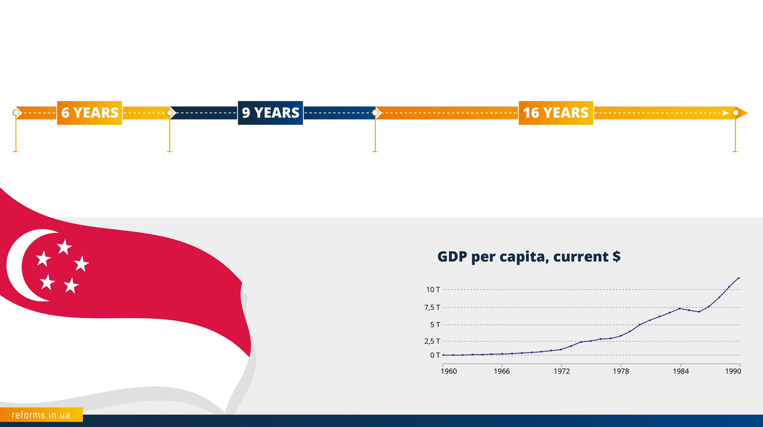
COUNTRY CASE:
SINGAPORE
1959
Lee Kuan Yew comes into power
1965
Independence
1974
First results
1990
Progress identified
In 1965, Singapore was so economically underdeveloped that it was necessary to import fresh water and cement. Neighboring countries were unfriendly. Malaysia closed its market for Singapore, and Indonesia actually declared war.

Slide 8
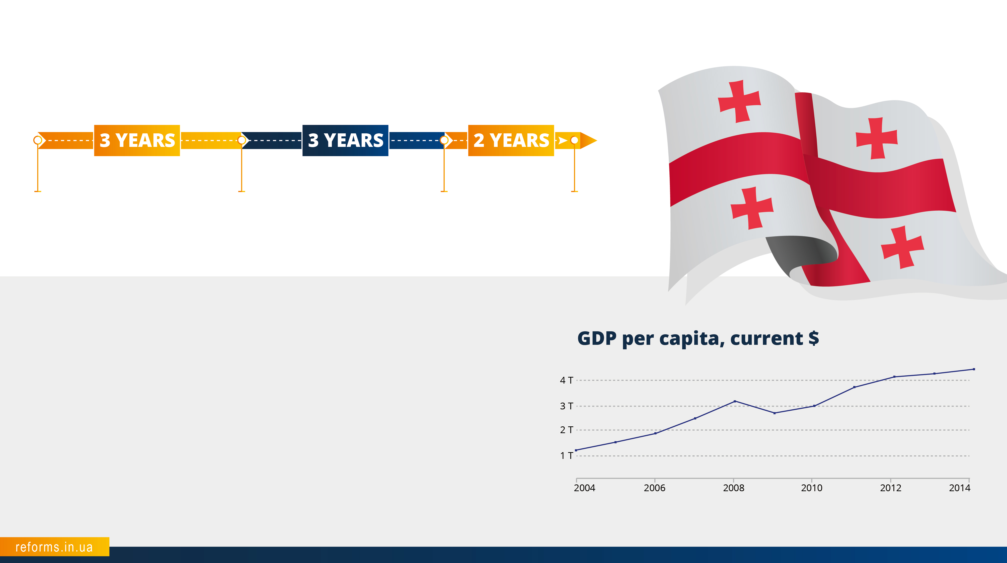
COUNTRY CASE:
GEORGIA
COUNTRY CASE:
GEORGIA
2004
The Rose Revolution. Beginning of reforms
2007
Starting Growth
2010
First results
2012
Transition to sustainable growth
Before the 2004 elections, Georgia was a half-collapsed state in deep economic turmoil. Over the next few years the new cabinet conducted extensive and effective changes.

Slide 9
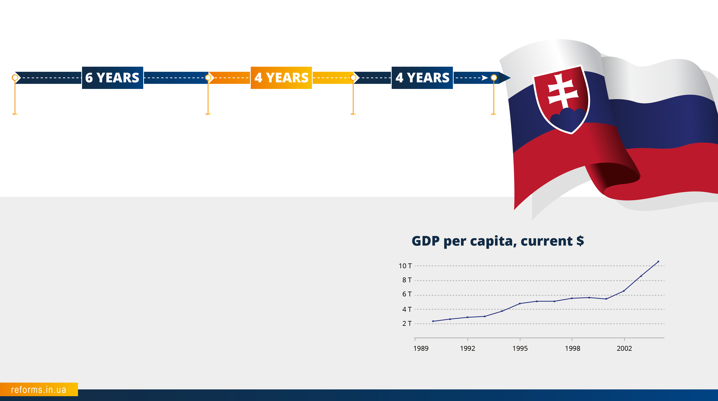
COUNTRY CASE:
SLOVAKIA
1998
Beginning of reforms
2004
First results and
admission to EU
2008
Progress identified
2012
Stabilization
In 1998, Mikuláš Dzurinda, an experienced politician became head of the government. Main sectors of Slovakia’s reforms were: public finance, tax and pension systems, health care, labor market and local government.
Fiscal incentives became the main instrument of the reformers’ policy. In the area of public finance, Slovakia strengthened budget transparency, implemented program funding, and planned three years ahead (versus one).

Slide 10
REFORMS PROGRESS
IN UKRAINE

Slide 11
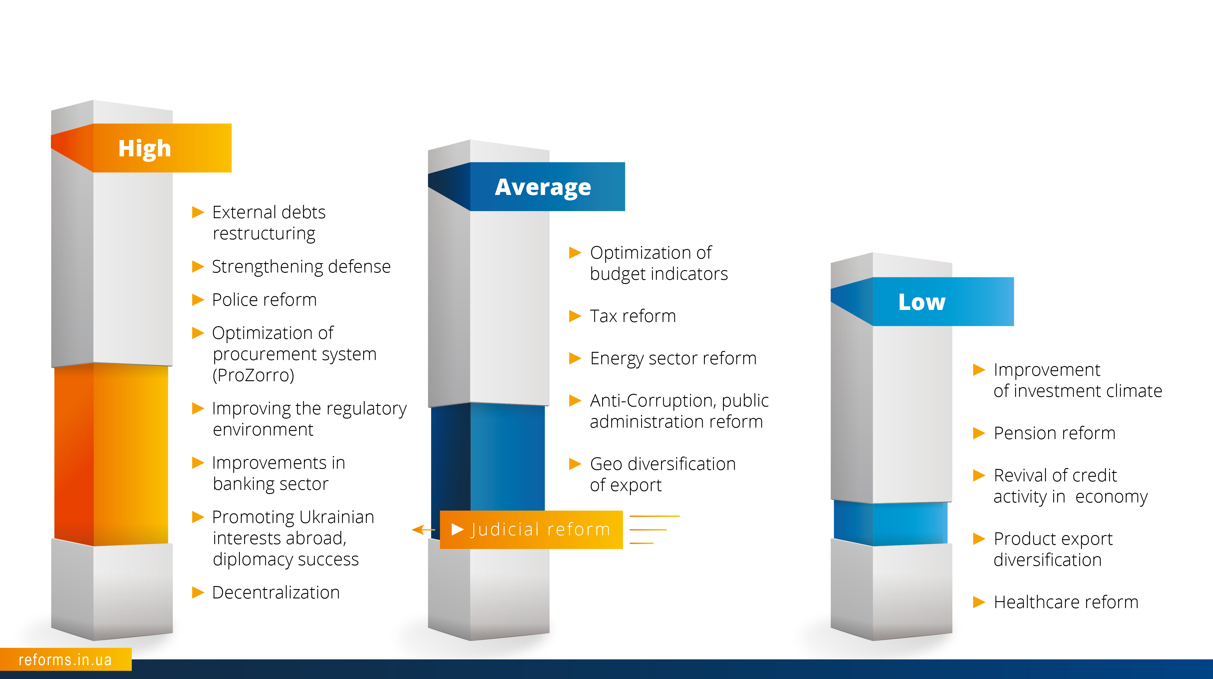
REFORMS
PROGRESS

Slide 12

REFORM PROGRESS:
ARMY
  APPROVED:
National Security Strategy (May, 2015)
Military Doctrine of Ukraine (September, 2015)
Concept of security and defense sector development (March, 2016)
State targeted defense program on weapons and development of military equipment by 2020 (March, 2016)
Strategic Defense Bulletin (May, 2016)
PERSONNEL:
Total personnel increased to 250,000 people
Over 52,000 people signed up for contract-based service
150 new recruitment centers are opened
Established: 15 brigades, 1 regiment, 5 separate battalions
115,000 people have been trained in higher military educational institutions
Fully restored combat capability of 14 brigades and 60 battalions
REFORMED:
Reforms started in the Ministry of Defense, General Staff, Armed Forces (aligned with NATO standards and approaches)
Logistic on NATO standards
Electronic procurement system ProZorro saved over UAH 180 mln
DEFENCE AND FACILITIES:
Defensive fortification line include 220 km of artificial obstacles and more than 500 command centers
1,400 hectares of lands and 21 valuable real estate properties returned to the Ministry of Defense under anticorruption program

Slide 13

REFORM PROGRESS:
ARMY
ARMY PROVISION IN 2014
… IN 2016

Slide 14

REFORM
PROGRESS
EUROPEAN
INTEGRATION
EU - Ukraine Association Agreement signed and provisionally applied
EU - Ukraine Association Agreement ratified by 28 EU member states in a year. Finalization of ratification process by the Government of the Netherlands is pending
Strong international pro-Ukrainian coalition formed
Ukraine met all EU requirements for visa-liberalization
Launched biometric passports for international travel of Ukrainian citizens
Opening European markets for Ukrainian companies, overcoming consequences of Russian embargo
DEREGULATION
Ukraine went up from position 112th (2013) to 83rd (2015) in Doing Business rating
More than 15,000 Soviet standards abolished
About 100 administrative barriers for business canceled
Quantity of permits cut from 143 to 84
List of activities that are subject to licensing decreased from 56 to 30
Electronic licensing introduced
Deregulation in agricultural sector: 28 permits cancelled, 28 simplified
The number of scheduled and unscheduled State Fiscal Service inspections decreased almost by half in 2015 compared to 2013

Slide 15

REFORM
PROGRESS
АNTI-CORRUPTION
The Law "On Government Cleansing“ (Lustration) adopted and signed
In October 2014 key anti-corruption laws on new anti-corruption institutions were adopted
National Anti-Corruption Bureau (NABU) was formed and started investigation.
Specialized anti-corruption prosecutor's office and the National Anti-Corruption Policy Council were established.
Based on the results of the open competition four members of the National Agency for Prevention of Corruption (NAPC) were elected.
State Bureau of Investigation and the National Agency for Identification, Tracing and Management of Assets Derived from Corruption and Other Crimes were legislatively established.
Legislative Acts concerning Fight against Political Corruption and Financing Political Parties were adopted.
Property registers became publicly accessible.
LAW
ENFORCEMENT
Police patrol has been launched in 32 cities, and staffed by over 12,000 persons
The Law "On the National Police" adopted.
Prosecutor’s office was deprived of powers of general supervision, and the new Law “On the Prosecutor’s Office” adopted.
The number of local prosecutor’s offices reduced by 23%, and administrative staff - by 75%.
The process of establishing the State Bureau of Investigation started.
JUDICIAL
REFORM
Amendments to the Constitution regarding the administration of justice and the implementing the Law on Judiciary and Status of Judges were adopted
Law "On Ensuring the Right to a Fair Trial" adopted.
New rules introduced: evaluation of the performance of judges, maintenance of judicial dossiers, qualification of examinations; new professional and ethical requirements

Slide 16

REFORM
PROGRESS
ЕNERGY SECTOR
Foundational law "On the Natural Gas Market" was adopted. The legal basis for the new European, open and competitive gas market established.
Significant diversification of gas supply sources. The volume of gas imports from EU increased from 8% in 2013 to 63% in 2015, Russian share reduced from 92% in 2013 to 37% in 2015.
Agreement with alternative suppliers of fuel for nuclear power plants signed.
Deficit of “Naftogaz of Ukraine” decreased from $ 8 bn to $ 1.5 bn in 2015; zero deficit projected for 2016.
Utility rates have been adjusted to the market level.
Western standards of the corporate governance have been implemented in “Naftogaz of Ukraine”
“Naftogaz of Ukraine” supervisory board (5 members) appointed (3 - independent members)
DECENTRALIZATION
Voluntary merger process was initiated in more than 6300 territorial communities; 159 capable communities formed.
Communities obtained additional financial resources as a result of financial decentralization.
Local government revenues increased by UAH 29.6 bn. (i.e. 42.1% ) in 2015 vs. 2014.
PUBLIC PROCUREMENT
Online system ProZorro became a cornerstone for optimizing government procurement and preventing corruption: 4,500+ contractors; savings exceed UAH 1.2 bn.
ProZorro received World Procurement Award 2016.
Ukraine joined WTO Agreement on Government Procurement, enabling access to public procurement markets of 48 countries (est. $ 1.7 trillion).

Slide 17

REFORM
PROGRESS
PUBLIC
ADMINISTRATION
New Law "On Civil Service" adopted. It clearly differentiate political and administrative roles in public service.
Quantity of public servants was reduced by 16%.
Updated State Portal for Administrative Services launched (poslugy.gov.ua).
Ukraine’s public sector efficiency indicator (Global Competitive Index survey) increased from 140th (in 2013) to 119th (in 2015).
STATE-OWNED
ENTERPRISE GOVERNANCE
For the first time financial statements of 780 state-owned enterprises (SOEs) had been published.
345 SOEs were approved for privatization.
Mandatory sale of 5 - 10% of shares before the auction was canceled.
Changes to the Law on JSC shareholders’ meetings decreased quorum requirements from 60% to 50% + 1 share.
For the first time international audit companies will audit 150 major SOEs.
For the first time reports on the top 100 state-owned enterprises have been published.
Market level compensation for the CEO’s of state-owned enterprises has been introduced.
For the first time special independent committee was established to select CEOs of 12 strategic enterprises (Ukrgasbank, Ukrgazvydobuvannya, Sumykhimprom and others). Eight of them had already been appointed.
Corporatization of the state railway company “Ukrzaliznytsia” started.

Slide 18

REFORM
PROGRESS
MANAGEMENT OF
PUBLIC FINANCE
Since 2014 the quantity of taxes and fees was cut from 22 to 11.
Electronic VAT administration system introduced.
Employer’s social payroll tax rates has been reduced from 41% (2014 average) to 22% in 2016.
Experiment on financing road construction and development from the surplus of customs duties has started.
Ukrainian foreign debt of more than USD 19.4 bn. was restructured.
The Law "On the Accounting Chamber" adopted.
Ministry of Finance launched E-data portal for monitoring public finance.
FINANCIAL SECTOR
78 insolvent banks were closed during 2014 - 2016; over UAH 70 bn of deposits returned to customers by state.
Budget deficit reduced from more then 11% (2014) to 3% (2015).
Macroeconomic situation in the country stabilized.
Е-GOVERNMENT AND
INNOVATIONS
3G introduced in 2015 (budget gained UAH 11 bn via transparent tender).
Open data portal - launched.
Electronic petitions to the President of Ukraine - launched. More than 21 000 petitions are registered YTD.
Other electronic services have been introduced including electronic apostil and access to public registers of the Ministry of Justice.

Slide 19
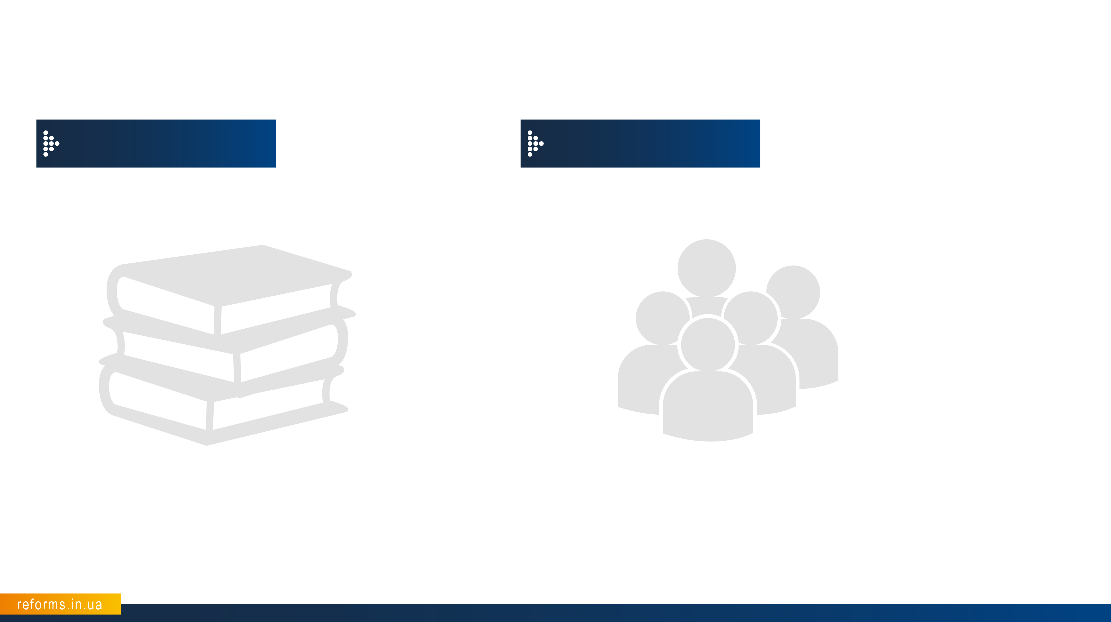
REFORM
PROGRESS
EDUCATION AND
CULTURE
Control over academic integrity (counteraction of plagiarism in theses) has been enhanced.
Launched “Go Global” - national initiative to promote learning English and other foreign languages across Ukraine.
Ukraine joined EU framework programme for research and innovation “Horizon 2020” (€80 bn).
Ukraine will be enrolled in Programme for International Student Assessment (PISA) in 2018.
Ukraine joined EU framework Programme “Creative Europe”
SOCIAL AND
POLITICAL AREA
New national holidays: the Day of Defender of Ukraine (October 14), the Day of Remembrance and Reconciliation (May 8).
Established celebration of the Day of the Heavenly Hundred Heroes (February 20) and the Day of Freedom and Dignity (November 21).
Decommunisation started (979 towns and cities, and 24 districts were renamed).
More than 1000 monuments of Lenin and over 150 monuments of other Soviet figures were demolished.

Slide 20
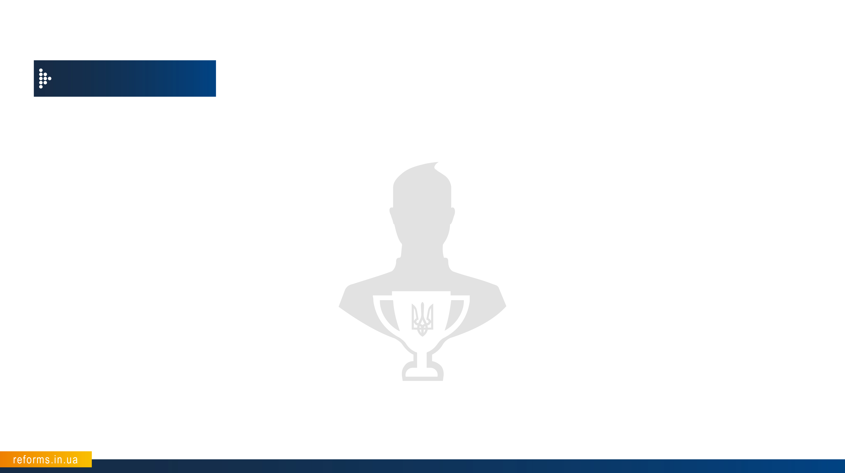
REFORM
PROGRESS
COMPETITIVE SELECTION
INTRODUCED
During the last 2 years more than 13 laws and 100 regulations were introduced for the competitive selection of:
Director and the staff of the National Anti-Corruption Bureau
Members of the National Agency for Prevention of Corruption
Prosecutors for supervising the observance of laws during investigation and search operations, as well as pre-trial investigation carried out by detectives of the National Anti-Corruption Bureau of Ukraine
Managers and prosecutors of the Specialized anti-corruption prosecutor’s office
Members of the High Council of Justice, members of the High Qualification Commission of Judges of Ukraine, judges, court staff
Police officers
Members of the Accounting Chamber
Head of the National Agency for Identification, Tracing and Management of Assets Derived from Corruption and Other Crimes
Director, deputies and staff of the State Bureau of Investigation
Civil servants and secretaries of the state
Leaders of all important state-owned enterprises
Heads of scientific institutions, Director of the Ukrainian Book Institute, heads of state and municipal museums, libraries, cultural institutions, heads of centralized library systems, heads of administrations of historical and cultural reserves.

Slide 21
CONCLUSIONS

Slide 22
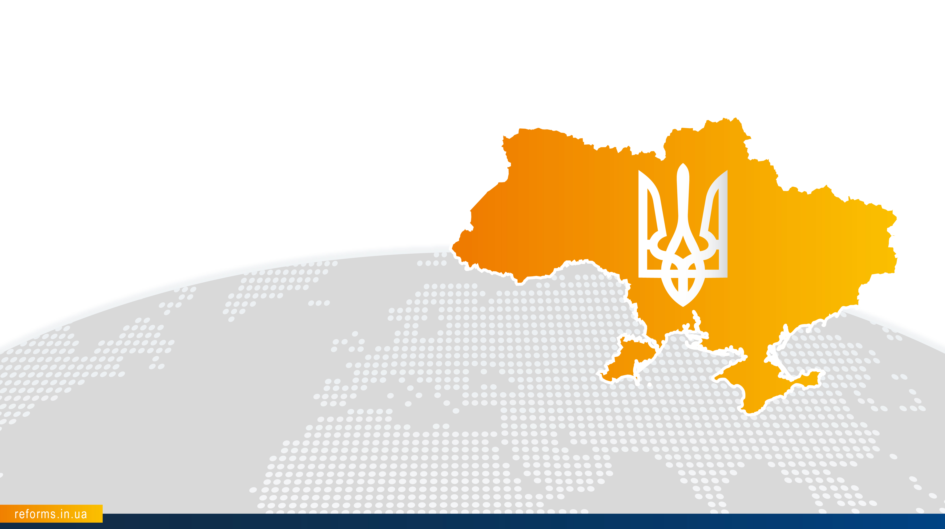
REFORM PROGRESS:
CONCLUSIONS
NO COUNTRY IN THE WORLD WAS REFORMING UNDER SUCH
CHALLENGING CONDITIONS

Slide 23

REFORM PROGRESS:
CONCLUSIONS
OUR GOAL:
INSTITUTIONAL CHANGES
Since 2014 we established the foundation for the new principles of governance.
We do not focus on names, but institutions.
«…Ukraine… is an example of how it is possible to reform institutions in a way allowing us to generate enormous amounts of goodwill among the Ukrainian people, because Ukrainians want to see these institutions move forward»
Geoffrey R. Pyatt,
Extraordinary and Plenipotentiary Ambassador US to Ukraine, May 16, 2016

Slide 24
REFORM PROGRESS:
CONCLUSIONS
OUR GOAL:
UNITY
Only through joint efforts of the President, the Parliament, the Prime Ministers, governments, coalition, civil society, army, diplomacy, donors, volunteers and all citizens of Ukraine
WE ARE ABLE TO ACHIEVE SUCH RESULTS AND PROGRESS.

Slide 25

REFORM PROGRESS:
CONCLUSIONS
Over the last 2 years Ukraine advanced on reforms more than other countries before.

Slide 26
WE HAVE DONE MORE THAN PERCEIVED, BUT LESS THAN WE ASPIRE FOR …

